Slide 1
Understanding Medicare
Presented by:
(Insert Presenter Name)
We do not offer every plan in your area. Any information we provide is limited to the plans we represent. For information on all your options, call 1-800-MEDICARE or visit Medicare.gov. Neither We Know Medicare, nor its agents, are connected to the Federal Medicare Program

Slide 2
Enrollment
Initial Enrollment – at age 65 or after age 65 when leaving employer coverage
OR
After 24 months with a qualifying disability at any age

Slide 3
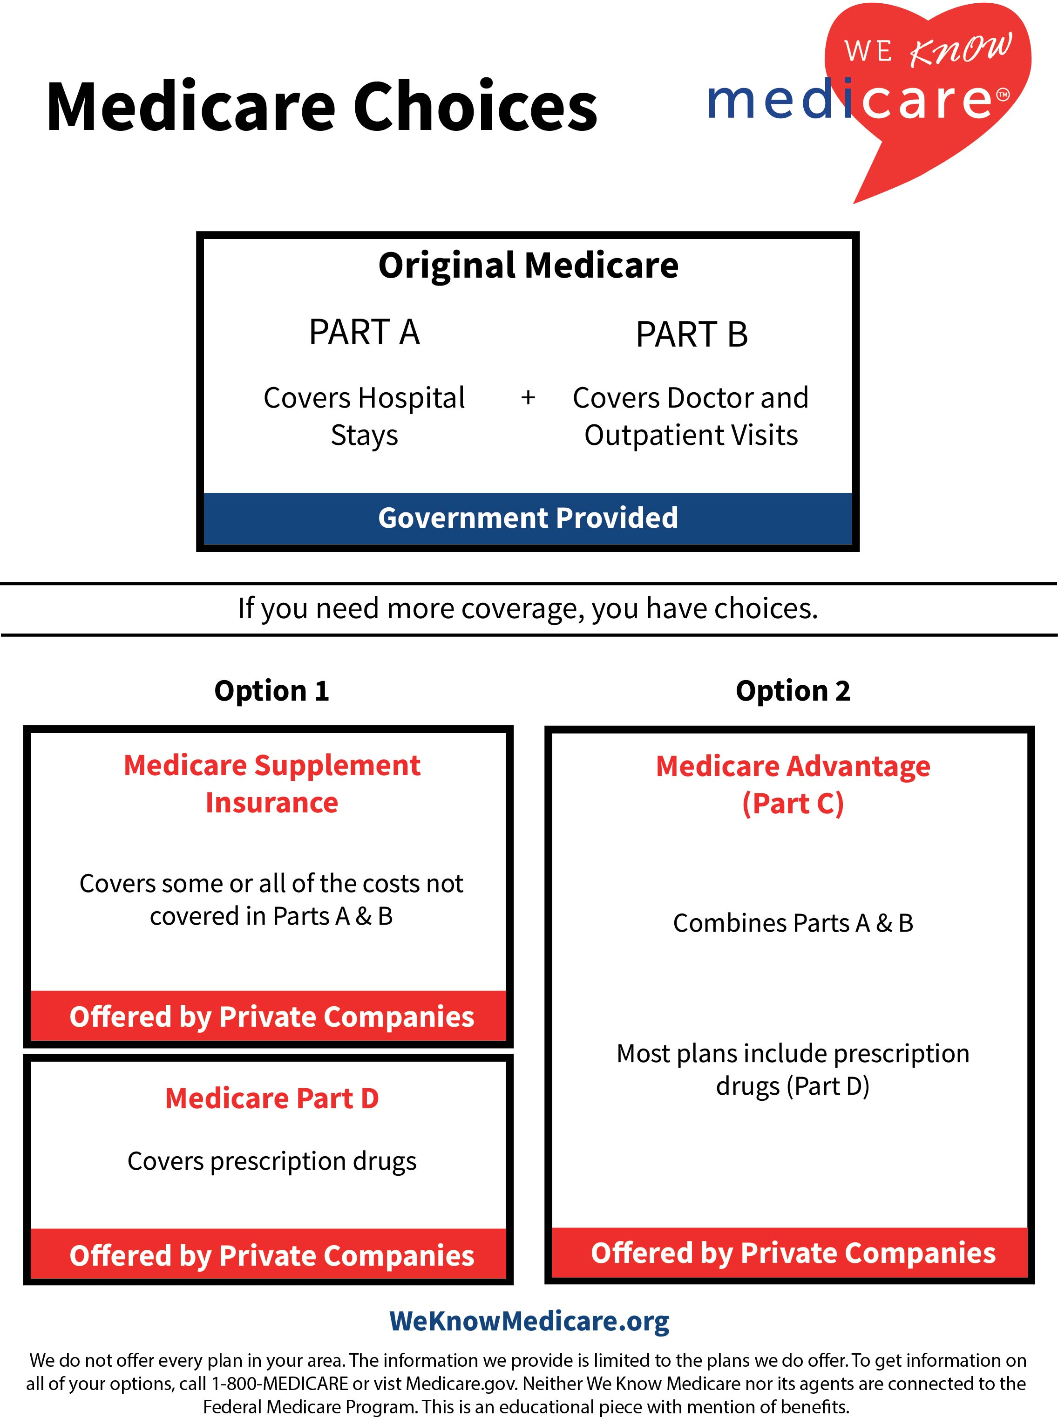

Slide 5
Part A
Provides coverage for hospital stays, skilled nursing care after a hospital stay and hospice
Most people don’t pay a premium
$1,600 hospital deductible (for each stay of up to 60 days) additional co-pays beyond that
Go to any hospital in the U.S. that accepts Medicare

Slide 6
Part A
Provides coverage for hospital stays, skilled nursing care after a hospital stay and hospice
Most people don’t pay a premium
$1,600 hospital deductible (for each stay of up to 60 days) additional co-pays beyond that
Go to any hospital in the U.S. that accepts Medicare
Notes:
This page is an animation page. It is illegible unless in presentation mode.

Slide 7
Part B
Provides help with out-of-pocket costs for doctor visits and other outpatient medical services
Premium is $164.90/month for most, if you have a higher income you may pay more
Annual deductible of $226
You pay 20% of the medical costs after the deductible is met and there is no cap on your total spending
Go to any doctor in the U.S. that accepts Medicare

Slide 9
Medicare Supplement Plans
Private insurance that pays some or all your out-of-pocket expenses for Medicare Parts A & B.
10 standardized plans – A through N
Premium costs can vary significantly from company to company and state to state.
Set monthly premiums versus unknown medical expenses

Slide 10
Medicare Supplement Plans
Private insurance that pays some or all your out-of-pocket expenses for Medicare Parts A & B.
10 standardized plans – A through N
Premium costs can vary significantly from company to company and state to state.
Set monthly premiums versus unknown medical expenses
Notes:
This page is an animation page. It is illegible unless in presentation mode.

Slide 11
Part D
Provides help with the cost of prescription drugs through private insurance companies
Each plan has its own formulary and pharmacy network
Costs can vary significantly from plan to plan
Your level of cost sharing is dependent on the specific prescription drugs you use
Notes:
This page is an animation page. It is illegible unless in presentation mode.

Slide 12
Part D
Provides help with the cost of prescription drugs through private insurance companies
Each plan has its own formulary and pharmacy network
Costs can vary significantly from plan to plan
Your level of cost sharing is dependent on the specific prescription drugs you use
Notes:
This page is an animation page. It is illegible unless in presentation mode.

Slide 13
Part D Cost Sharing
Annual deductible of up to $505
Initial coverage limit of $4,660
Donut hole or coverage gap
Catastrophic coverage - $7,400 and above
Drug copays drop to $4.15/$10.35 or 5% whichever is higher
Notes:
This page is an animation page. It is illegible unless in presentation mode.

Slide 15
Medicare Part C Advantage Plans
A single plan offered by private insurance companies that combines coverage for Medicare Parts A & B. Most Plans include Part D
Must cover all services provided by Original Medicare
Provides a maximum out of pocket on medical expenses
May offer additional benefits

Slide 16
Medicare Part C HMO Plans
Must receive care from in network doctors and hospitals
Care outside of network is not covered – unless it is an emergency. Some plans also provide urgent care services out of network
Referrals from primary care doctor typically required to see specialists

Slide 17
Medicare Part C PPO Plans
Receive care from in network or out of network doctors and hospitals
May have higher co-insurance or co-pays for out of network care
Referrals from primary care doctor not required

Slide 18
Medicare Comparison
Supplement Plan
Medicare Advantage
Higher premiums
More comprehensive coverage
Any provider who accepts Medicare
Stand alone Part D
Covers only Original Medicare benefits
Low to no premium
Pay as you go
Network Provider
Built in Part D
May offer additional benefits

Slide 19
Contact Us
Presenter Name
(Insert presenter email)
(555) 555-5555

